Slide 1

Genetic Algorithms for Airline Crew Scheduling
Prepared by: Aena Parekh
Akash Kumar
Aundeep Yathepu
Supervised by: William Pourmajidi
Institution: Masters of Data Analytics

Slide 2

Introduction
Prescriptive analytics = recommends best actions
Airline crew scheduling = critical optimization task
Crew costs = 2nd largest airline expense
Traditional solvers (CPLEX, Gurobi) → slow
Solution: Parallel Genetic Algorithm (GA) framework
Source: Ouyang & Zhu (2023)

Slide 3
Problem Statement
Assign flights to crew under strict rules
Constraints: duty hours, rest time, regulations
Two sub-problems: Crew Pairing (CPP), Crew Rostering (CRP)
Problem is NP-hard → grows exponentially
Existing solvers = inefficient for large datasets

Slide 4


Optimization Model
Decision Variable: xij = 1 if crew is assigned to flight j, else 0
Objective Function: Minimize total scheduling cost
Constraints: Flight coverage, Duty hours ≤ MaxDT, Rest ≥ MinRT, Feasible pairings
Definitions: C = crew set, F = flights set, cij = assignment cost
Adapted from Ouyang & Zhu (2023)

Slide 5

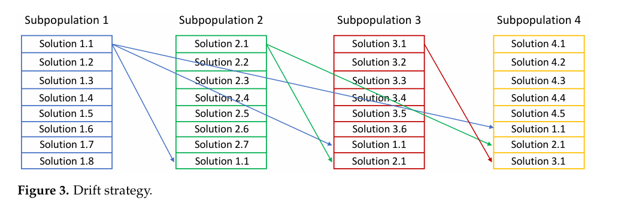
What is a Genetic Algorithm?
Metaheuristic inspired by evolution
Works with a population of solutions
Operators: Selection, Crossover, Mutation
Iterative → near-optimal solution
Effective for large, complex problems

Slide 6

Parallel GA Framework
Integrates CPP + CRP in one model
Uses parallel multi-threading (MPI)
Drift strategy → populations exchange info
Achieves: Faster convergence, Higher stability, Better scalability

Slide 7

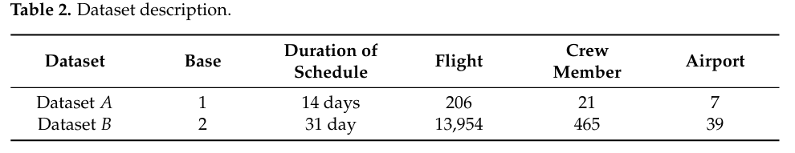
Dataset & Setup
Dataset A: 206 flights, 21 crew, 7 airports
Dataset B: 13,954 flights, 465 crew, 39 airports
Compared: Traditional GA, CPLEX, Gurobi
Metrics: flight coverage, utilization, runtime

Slide 8
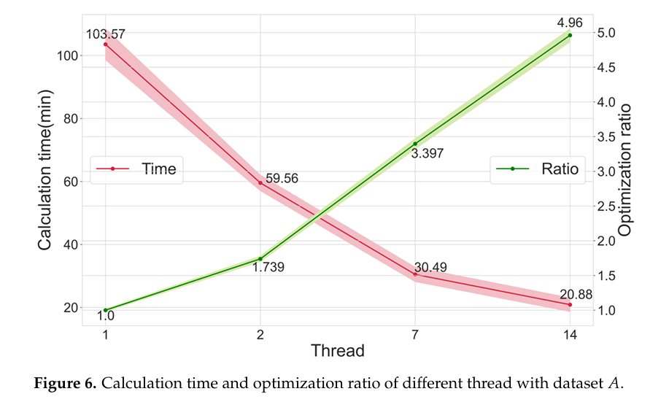

Results: Dataset A
Flights matched: 96.6%
Runtime: 85% faster vs CPLEX
Crew utilization: ~44 flights/month
Stable for small scheduling problems

Slide 9

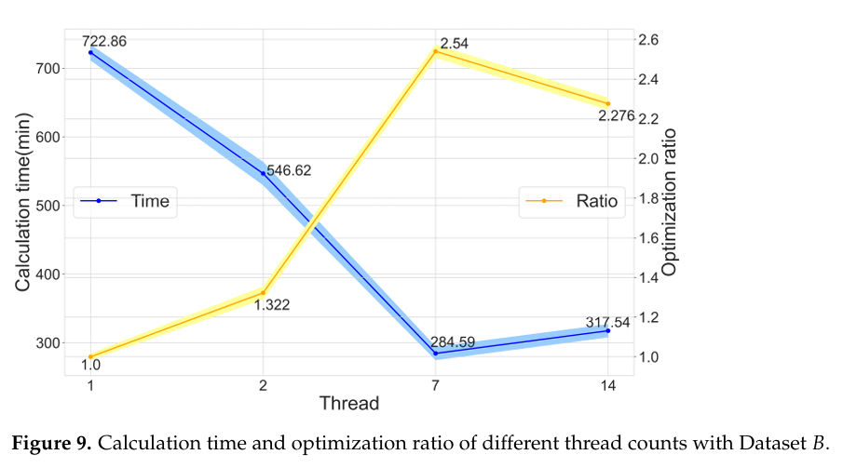
Results: Dataset B
Flights matched: 93.4%+
Runtime: 45–60% faster
Solved 13,954 flights efficiently
Outperformed Gurobi & traditional GA

Slide 10
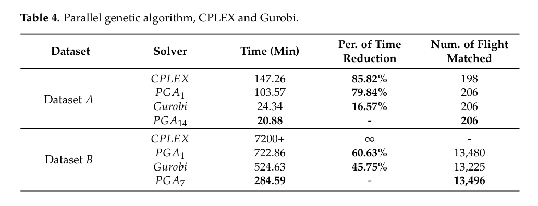
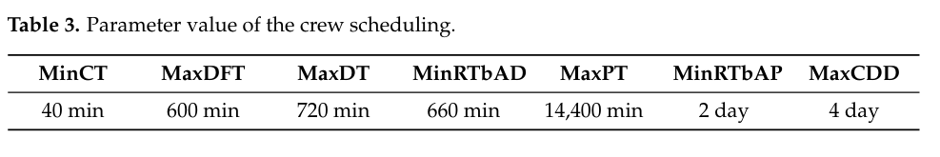
Solver Comparison
CPLEX: 198 flights, 147 min, Low efficiency
Gurobi: 13,225 flights, 524 min, Moderate efficiency
Parallel GA: 13,496 flights, 284 min, High efficiency

Slide 11


Business Impact
Airlines save millions annually
Handles crew shortages effectively
Improves crew utilization & fairness
Reduces delays & cancellations
Applications: logistics, manufacturing, healthcare

Slide 12
Reflections & Conclusion
GA = robust metaheuristic for optimization
Parallel GA = 2.5–5x faster than solvers
Scales from small → large datasets
Strong business value demonstrated
Future: GA + ML → predictive crew scheduling

Slide 13
Reference
Ouyang, W., & Zhu, X. (2023). Meta-heuristic solver with parallel genetic algorithm framework in airline crew scheduling. Sustainability, 15(2), 1506. https://doi.org/10.3390/su15021506

Slide 14

Thank You

